Slide 1
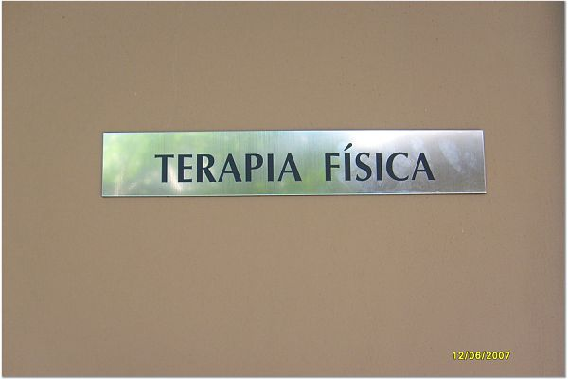
Global Health Service Learning, HRS 7700S, 1 credit 3rd year elective
Merida,
Yucatan, Mexico

Slide 2
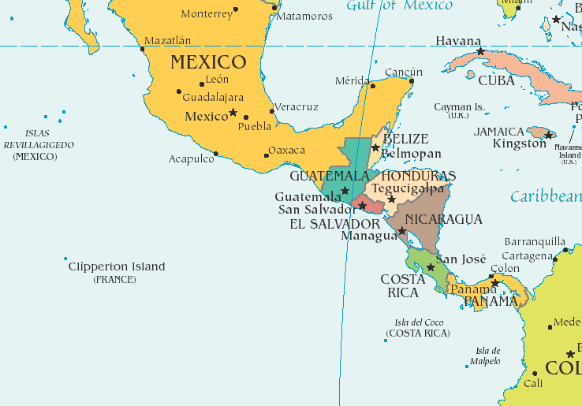
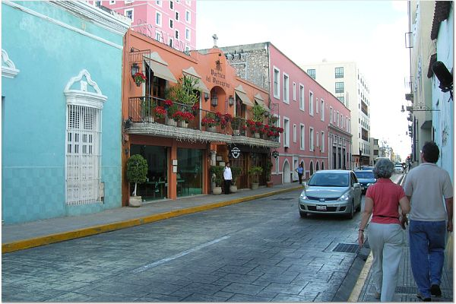
Mérida, Mexico City of over 800,000 Capital of the state of Yucatan UNESCO World Heritage Site

Slide 3
Facts to Get Started
Class of 2020 will be eligible for the trip in Dec. 2019
Departure- Tuesday after Thanksgiving
Return- 2nd Saturday in December (nighttime)
Application process will be explained and occur during Fall Admission to the course is by application only.
7700S students/service-learning/pages/index.aspx
The last 3 slides contain safety information
For more information or questions, contact Anne Kloos, anne.kloos@osumc.edu

Slide 4
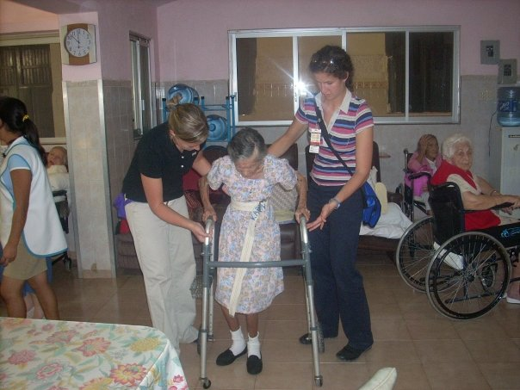
Why Should You Consider A Global Health Service Learning Elective?
Experience combining the provision of PT services while you will learn and share with everyone around you
AND
have the opportunity to reflect on the work that was done,
the appropriateness
of that work and
changes that might
occur as a result of
your work.
Apply all of your
knowledge in new
places with people
who are very appreciative.

Slide 5
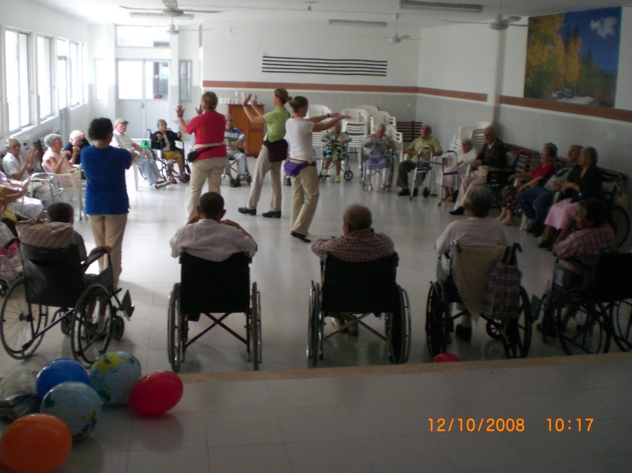
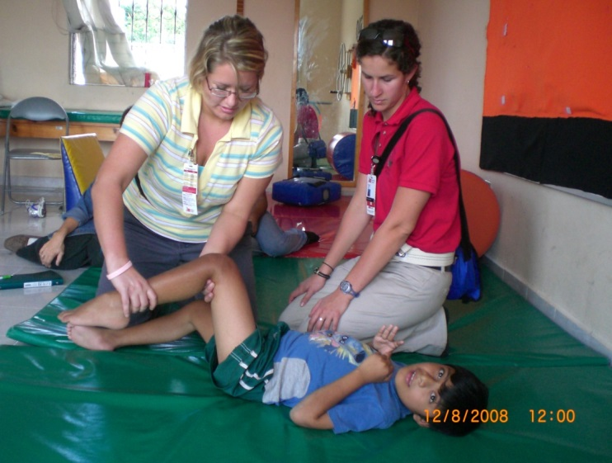
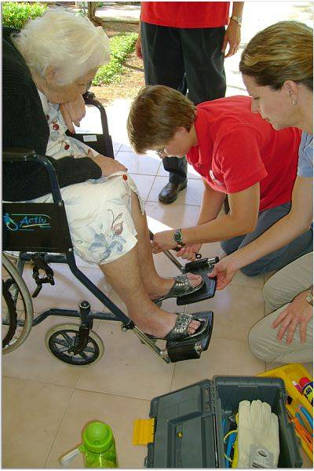
This experience opens lots of discussion with potential employers
Unique practice opportunities with a variety
of patients
of all ages

Slide 6
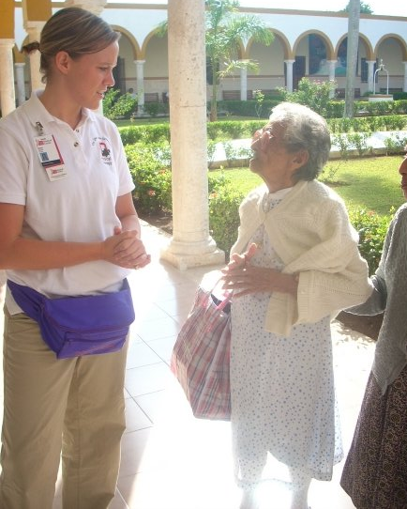
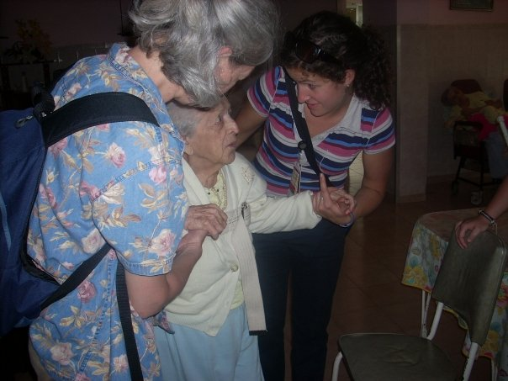
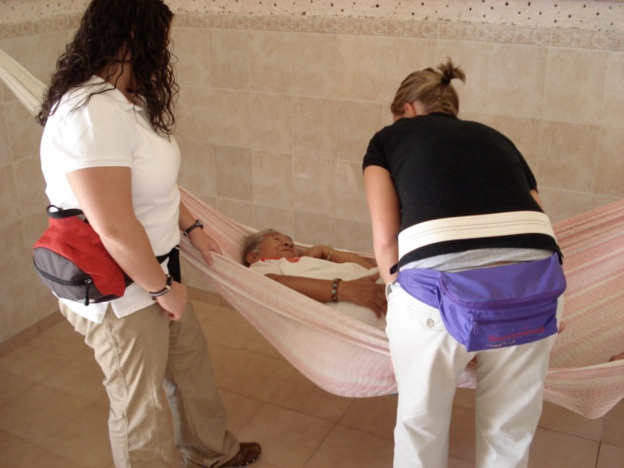
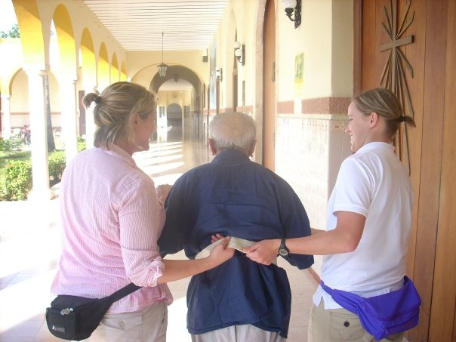
What is the work like?
Every facility has strengths and
needs that are unique.
We work to help address needs that the Staff have identified.
We work in residential facilities for people with multiple needs, an orphanage, nursing homes, a school, an aquatic center with children with disabilities

Slide 7
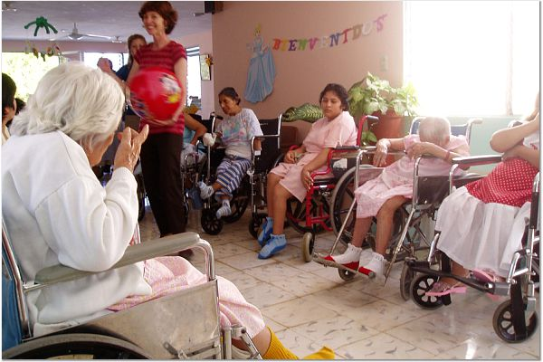
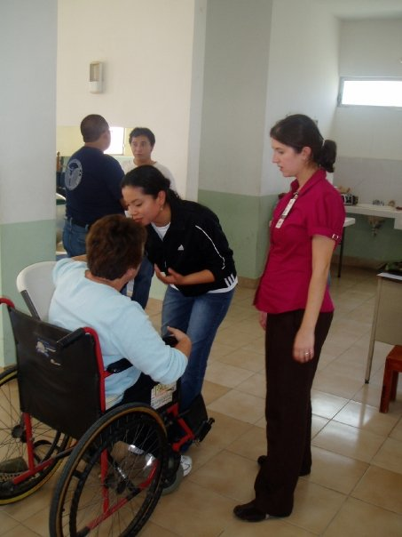
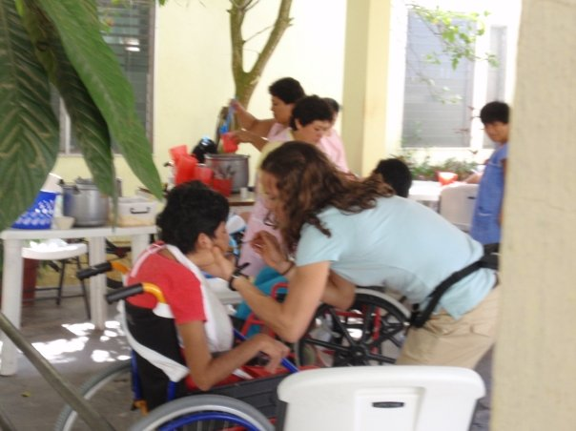
While knowing some Spanish is helpful, being "bilingual" is NOT necessary
We work with a team of interpreters
Each team has
one faculty member, 1 interpreter,
2-3 students

Slide 8
ROM and transfers to and from a hammock are a couple of the unique experiences blending therapy and culture.

Slide 9
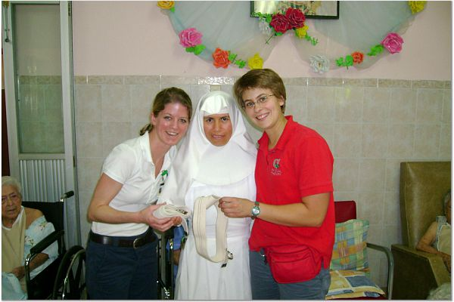
Gait belts- an ongoing part of our work. We have some challenging issues surrounding safety of the patients and staff that we address each year.

Slide 10
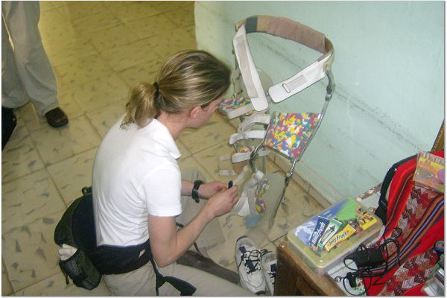
We spend quite a bit of time patching together rehab equipment. The fixes are appreciated although they may be less than ideal. We try to do “the best we can do with what we have.”

Slide 11
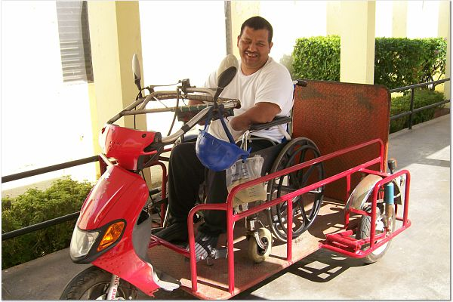
We see some very creative solutions like this one, wheelchair on a scooter

Slide 12
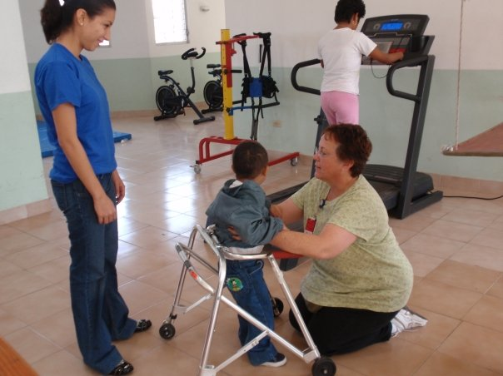
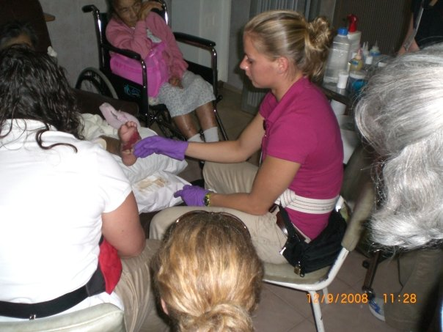
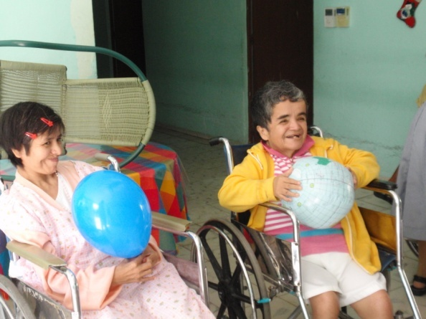
Documentation is
just starting in some sites. We help with implementation.
We teach patients by using resources that are available and
appropriate.
Creativity is important!

Slide 13
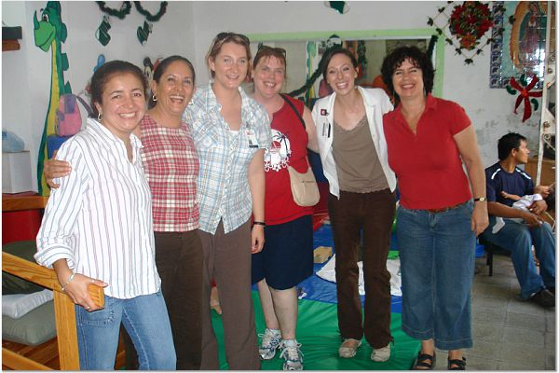
We’ve developed great relationships with facility staff and our interpreters. Some of the sites have bilingual staff

Slide 14
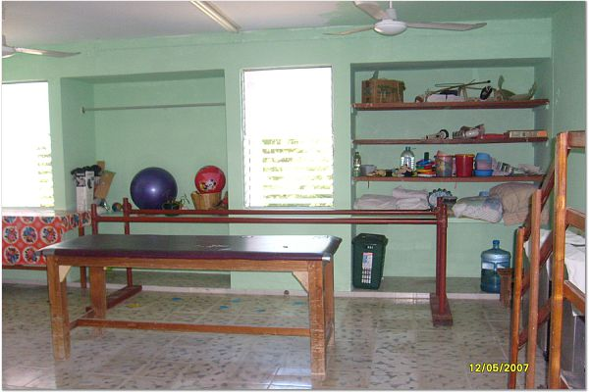
Cuidad Vicentina is one of several residential facilities where we work. We work throughout the facility and in the therapy room. We also work at an outpatient clinic, a school and rehab center for people of all ages, and a pediatric outpatient program in their aquatics program.

Slide 15
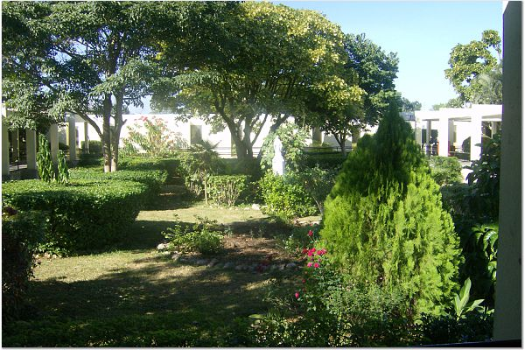
Several facilities have beautiful gardens. For other facilities, the physical conditions are in need of lots of TLC.

Slide 16
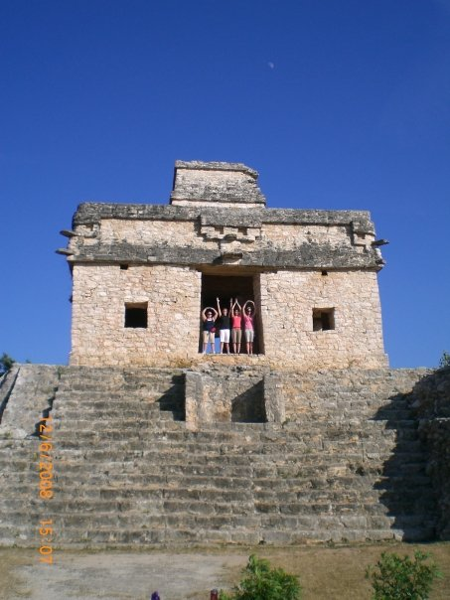
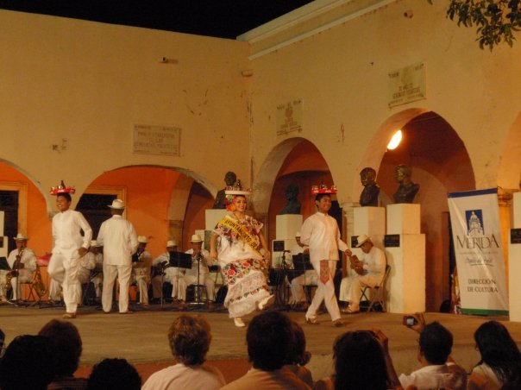
Work for 8 days
Enjoy evenings and weekends with cultural activities. Yes, there is free time.
The state crime rate is lower than the rate in Wyoming

Slide 17
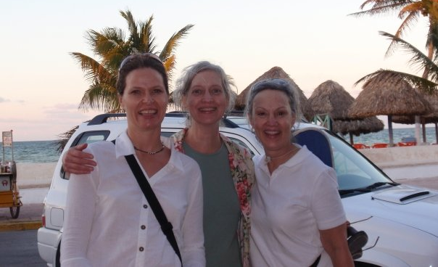
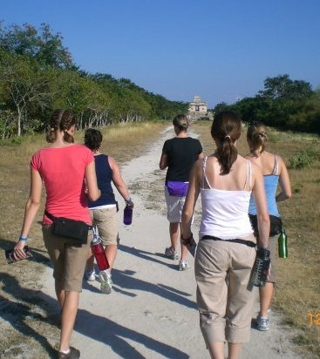
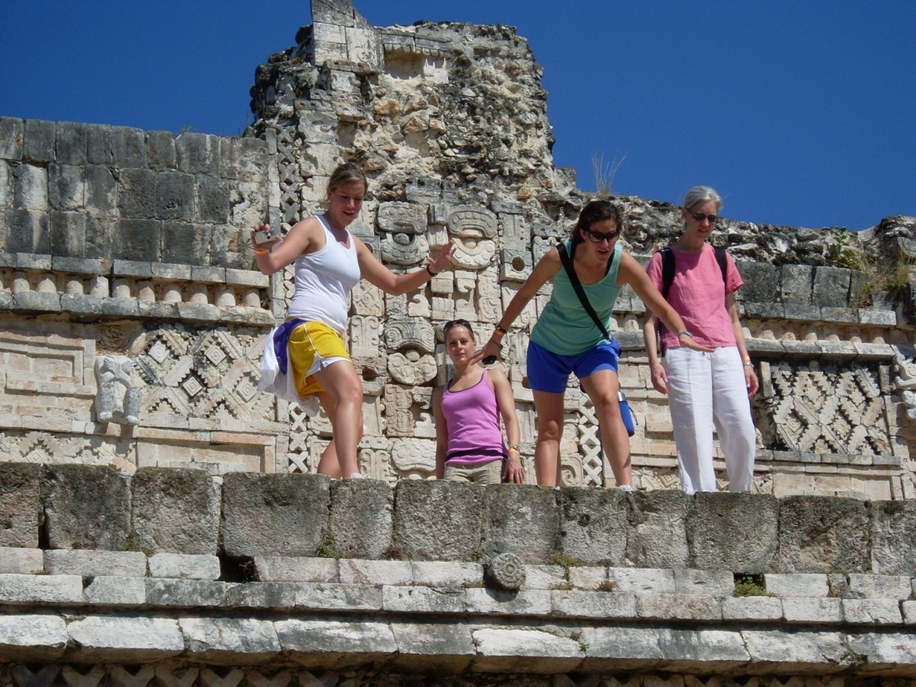
Almost too much to do
Notes:
Get to know Dale D, the Kloosinator other great PT’s and your classmates☺
Learn from the best CI’s imaginable
Cherades?
Eat cake without your hands, pinatas
Swim in your skivvies!

Slide 18
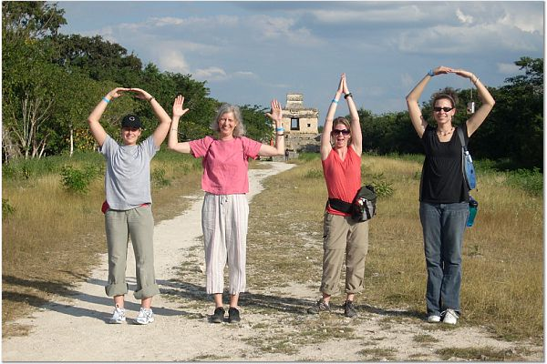
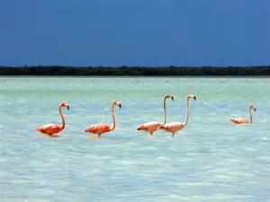
The Weekend
Dzibichaltum: Saturday
Celestun: Sunday
Older than Chichen Itza
Museum + Cenote
Small beach town with biosphere reserve
Flamingoes + beach time

Slide 19
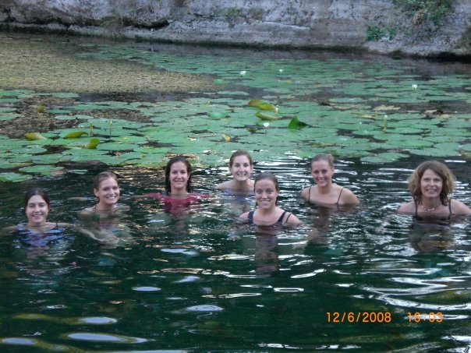
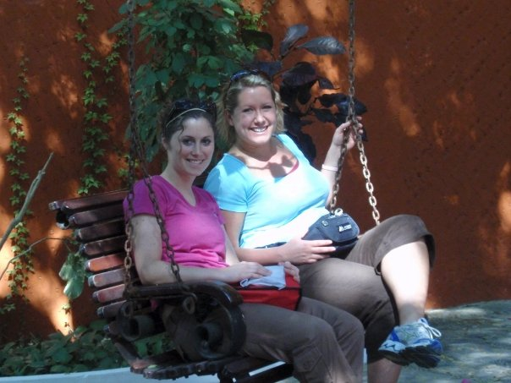
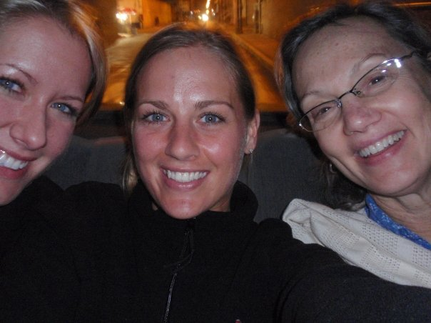
Swimming in crystal clear cenotes is a great way to cool off!
Spending time with classmates and
faculty is an unforgettable experience

Slide 20
Financing Overview
All costs except airfare, personal spending and 3 dinners are included on the fall semester tuition bill, as a lab fee. The trip fee will be ~ $1300.
No money is paid prior to announcement of the exact fee. Cancellation policy is explained in detail at that time.
Trip fee includes lodging, interpreters, transportation to and from the airport and to and from work and group outings, guides and admission fees, breakfasts, lunches and most dinners, international health insurance
Air flights are booked and paid for by each student
Student fund raising has been done by each group

Slide 21
Resources
We stay at Casa Milsaps. Provided: AC, Breakfast, food for packed lunches, daily room cleaning, laundry, splash pool, roof top sitting area and more. Check it out at
http://www.casamillsapsmerida.com/
This site has a wealth of information about Merida and Yucatan
http://merida.gob.mx/turismo/index_in.htm

Slide 22
Safety Details 1of 3 slides
OSU will not permit trips to be taken if there is a known security or safety risk.
2. OSU’s Office of International Affairs (OIA) assists in trip planning. They keep the course faculty informed about safety concerns.
3. OIA provides training for faculty in emergency procedures. The faculty has access to emergency phone contact with OSU on a 24-7 basis.
4. All students complete a required OIA orientation that includes emergency procedures. Each student receives written safety tips in the orientation booklet.
5. Each student and faculty on the trip must register with the US State Department prior to departure. OIA ensures that no one is on the trip without completing this registration. The State Department notifies travelers in case of changes in risk, including weather and security, should that be needed and so serves to assist the traveler should they have any problems related to lost passports or significant health problems. There is a US consultant office in Merida.

Slide 23
Safety, 2 of 3
6. Merida is the safest capital city of any state in Mexico and has been for some years. Merida, the capital of the state of Yucatan, has the lowest crime rate of any state capital in Mexico. We have had wonderful uneventful trips and never had any concerns about safety.
7. There is a police presence in and around the city. Vviolence is a very rare occurrence. The violence that continues to receive so much publicity in the US has been mainly in the states that border on the US, Mexico City, Acapulco and to a lesser degree in the state of Quintana Roo on the southern coast of the Yucatan Peninsula where Cancun is located. Merida continues to be as safe as many, many places in the US. In 2010 an article in the NY Times reported that the incidence of violent crimes in the state of Yucatan was less than in the state of Wyoming.
8. For updates on travel topics, including safety of areas in Mexico the US State Department website is an excellent source of current information. http://www.state.gov/travel/ OIA and course faculty receive regular updates from the US State Department about warnings for Mexico. Warnings have not been posted for the state of Yucatan.

Slide 24
Safety, 3 of 3
9. Our housing in Merida is a very safe location in an area that has some residences and small businesses. The neighborhood is within a few blocks of luxury hotels and central historic area of the city. Casa Millsaps, http://www.casamillsapsmerida.com/location.php
is owned and operated by Millsaps University in Jackson, MS. It is located on a quiet street is secured with a locked gate. There is an manager who assists our group in maintaining a safe environment within the house and the city.
Casa Millsaps has a direct phone line to the US which is available to us.
10.We take precautions to safeguard all members of the group that include: traveling in groups of at least 3 during the day and evening, ensuring the exterior door at Millsaps is locked 24 hrs a day, keeping all possessions locked in car trunks when we are not in the cars, traveling on well traveled major roads to work each day and wearing conservative dress. On the first day, the course faculty reviews safety information with the students and reiterates this information throughout our trip.

